Slide 1
LookUp Functions in Excel 2016
Vlookup and Hlookup functions

Slide 2
Let’s start with Vlookups
Vlookup formulas look for matching information between two tables and put it in another table.
What you need to decide:
What are you looking for?
Where is your table with the new information?
What column of the new table has the information?
Will you lookup exact matches or will it be on a sliding scale?
BTW: Vertical is from the top to the bottom.
Lookup functions allow you to use separate tables of data to find a matching value in the first column of a table and insert the new data to the right in the original worksheet location.

Slide 3
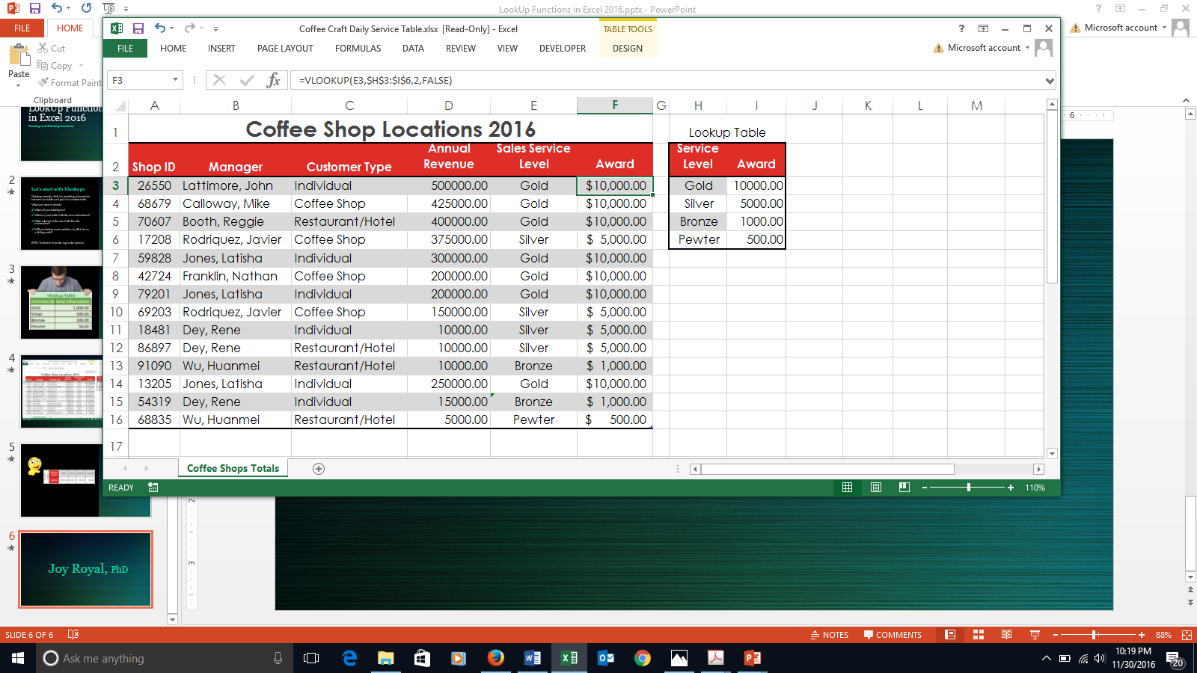
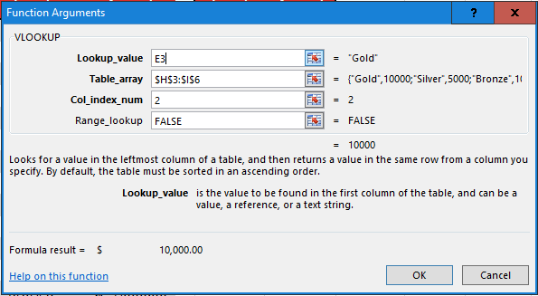
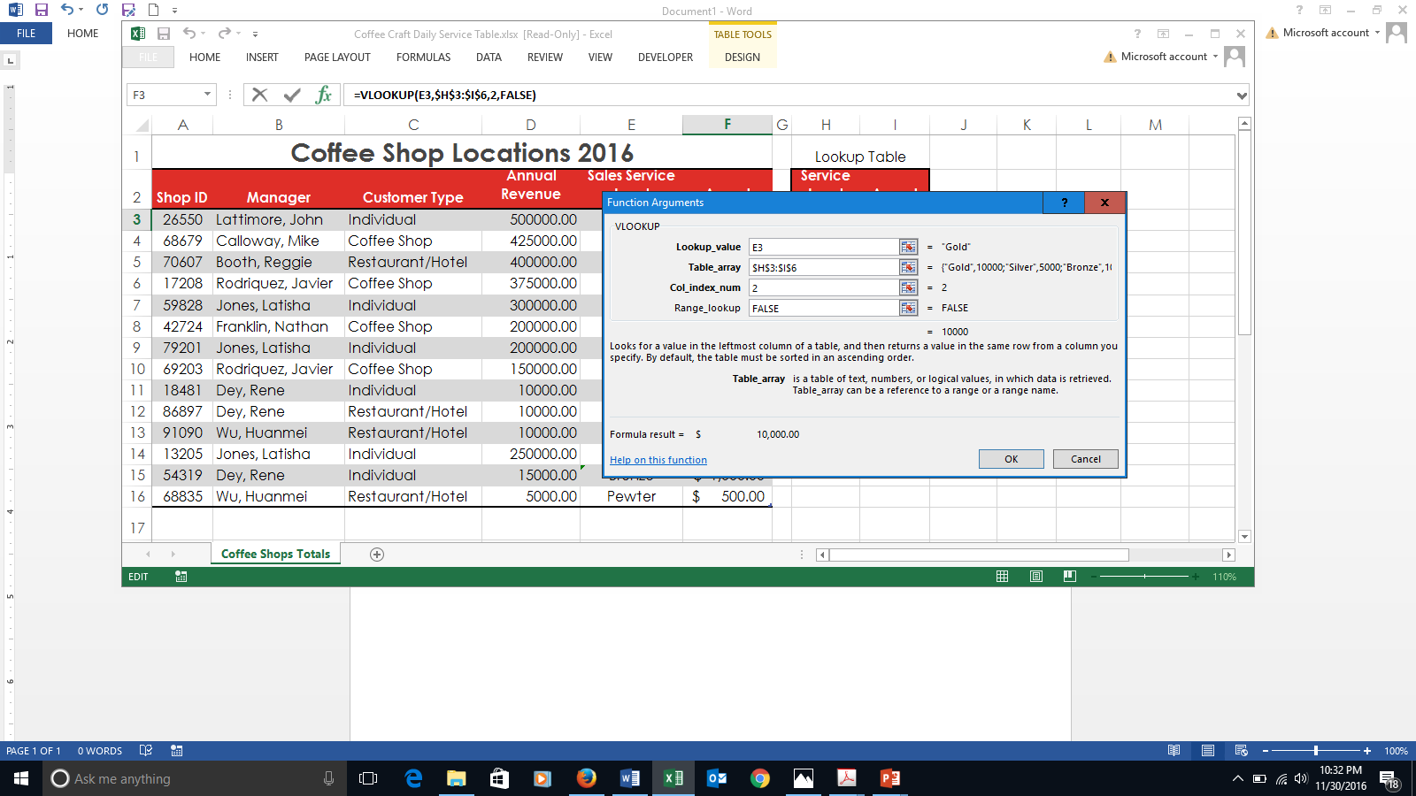
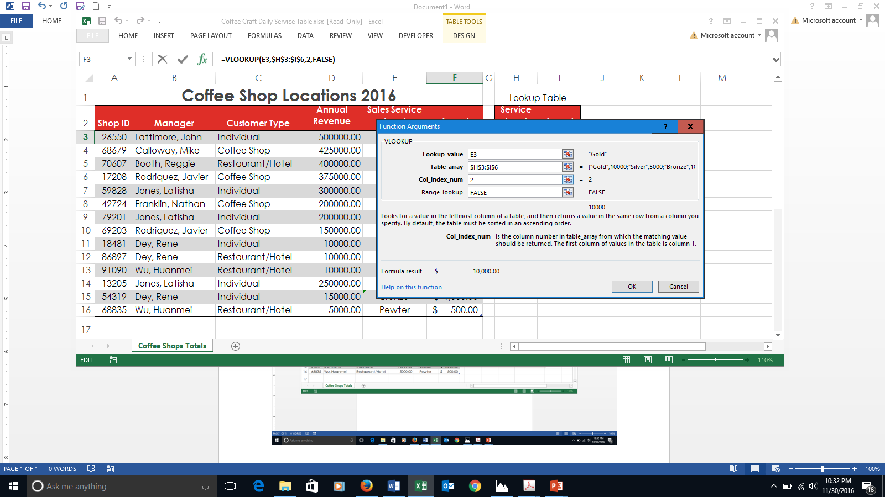
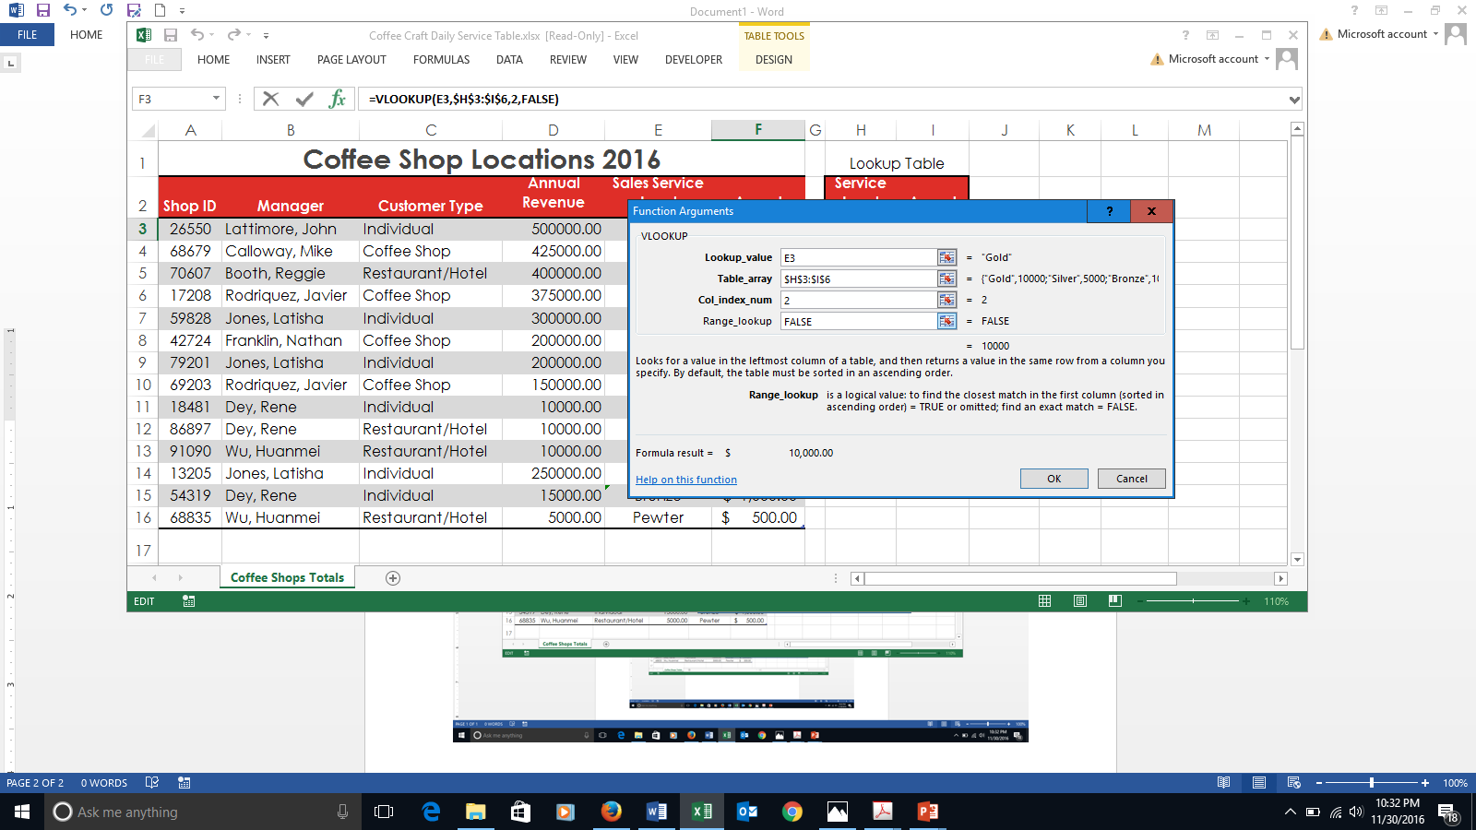
V Lookup
This formula is matching the value in E3 with the exact matching value in the left column of the lookup table.
The value that is on the right of the matched value, will be entered into the field where your cursor is located.

Slide 4

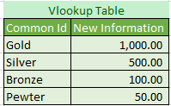
VLookup
Look Vertically to find information to the right that you want to place in another table.

Slide 5

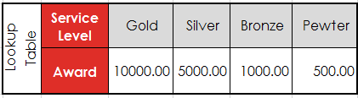
HLookup
  Works just like the VLookup except…
  You look HORIZONTALLY and find information below the match.

Slide 6
Joy Royal, PhD

